Slide 1

SAP Analytics cloud training
Anubhav Oberoy
Day 6

Slide 2
Agenda – Day 6
Classification Concept and Scenario
Confusion Matrix
AUC and ROC Curves
Profit Simulation
ML Scenario – Classification
---Break---
Regression Concept and Scenario
Concept of Regression
Determination of MAPE
Concept of Residuals

Slide 3

















Slide 4

Machine Learning Scenario – Classification
Scenario 1: I want to run a marketing campaign but the number of customers are huge and budget is limited.
If I run the marketing campaign for all my customers → it will incur huge cost
I will randomly select some customers and run campaign only on them → probability of getting the response is very low
Outcome:
Positively – 1 – High probability to get the response
Negative – 0 – Low probability of getting the response
10 Mn (Leads) X 1$ = 10 MnUSD
2 Mn USD → 2 Mn Customers
When we want to classify group of members (population) into 2 groups (1,0 - binominal). This type of problem is called classification. The rule which used to perform the classification is called classification rule.
www.anubhavtrainings.com

Slide 5
Concept of Dependent and Independent Variables
Requirement – we have received data from a hospital about all the patients who has/not has heart disease and also the health habits and current state of the patient.
Input → Independent Variables
X1, x2, x3, x4….
Output → Dependent Variables
Formula - Algorithm
Chest Pain | Good Blood Circulation | Sugar | Weight | Has the heart disease
Yes | No | Yes | Yes | Yes
No | Yes | No | No | No
Yes | Yes | Yes | Yes | Yes
Yes | No | No | No | No
No | No | Yes | Yes | Yes
No | No | No | Yes | No 0
Yes | No | Yes | No | Yes 1
Yes | No | NO | Yes | No 0
No | No | No | Yes | No 0
Formula - Algorithm
Formula - Algorithm
Training Dataset
Formula - Algorithm
Model
Model
Model
Validation dataset
Model
Output
Validation dataset
Model
Output
Yes 1
Yes 1
No 0
No 0
Actuals
Y1,y2,y3….
Predicted Result

Slide 6
When to use What?
What is classification and when to use?
If the outcome (dependent variable) is a binominal nature. We apply classification.
Regression
When the dependent variable is of continuous nature (NUMBER), we use regression.
To determine the dependent variable, we use different mathematical algorithms, we will get different results which we compare with actual results and determine the accuracy, prediction power. What is the process of determining accuracy, pp:-
→ Confusion Matrix → ROC Curve → AUC Curve

Slide 7
What is confusion matrix?
I did a sampling of 200 patients and we provided the validation data set (actual result was known) to a model, the model produced predicted outcome for those 200 patients. Then we write confusion matrix like below
Sampling Size 200 | Actual 1 (had heart disease) | Actual 0 (not had h disease)
Predicted 1 (Machine saying he/she has HD) | 70 (True Positive) TP | 20 False Positive (FP)
Predicted 0 (Machine saying he/she not has HD) | 30 FN – False Negative | 80 True Negatives (TN)
www.anubhavtrainings.com

Slide 8













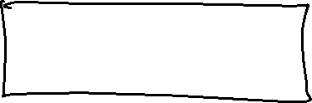








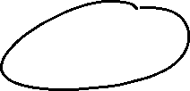

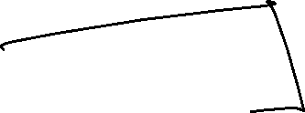




















Slide 9
ROC and AUC
If we check our accuracy with different-different models (200), system will product 200 different matrixes, which are difficult for us to compare manually, so we rely on the ROC Curve, which is easy as compared to matrixes to compare.
ROC (Receiver Operating Characteristics – Plat between TPR v/s FPR)
www.anubhavtrainings.com

Slide 10
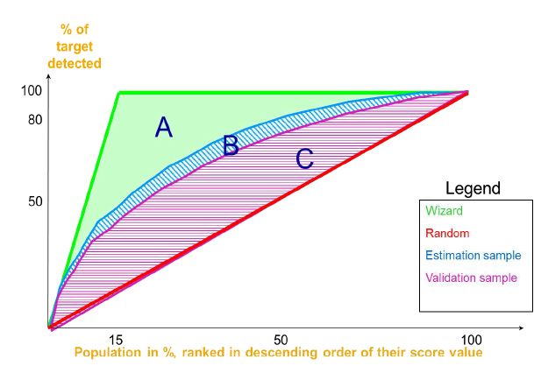
Metrices
Metrics | Definitions
Classification Rate | Percentage of targets accurately classified by the model when applied on the validation data sets (TP+TN) / N ~ also known as accuracy of model
Sensitivity (TPR) | Percentage of actual positive targets that have been correctly predicted. TP/(TP+FN)
Specificity (FPR) | Percentage of negative targets that have been incorrectly detected as positive. FP / (FP + TN) = 1 - specificity
Precision | Percentage of predictive positive targets that are actually positive targets. TP/(TP+FP)
FI score | Harmonic mean of Precision and Recall (Recall and Precision are evenly weighted). F1 = 2 (Precision X Recall) / (Precision + Recall)
Predictive power represents how close to the perfect model the model is (quality)
Area between Validation and Random curves divided by the area between Perfect and Random curves = C/(A+B+C)
= 0 ➔ Bad quality >= 0.98 ➔ certainly dependent variables between 0.75 and 0.97 ➔ quality acceptable
Prediction confidence expresses the ability to reproduce the same detection (robustness)
You need a « validation sample » to estimate this KPI: it represents another view of the same population
1 – (area between Validation and Training) / (area between Perfect and Random) = 1- B/(A+B+C)
>= 0.95 ➔ good robustness
www.anubhavtrainings.com

Slide 11
Profit Simulation
Classification Rate > 0.75 ~ 0.95 – Good Model
Confidence > 0.90

Slide 12
Regression Concept
If our machine learning scenario would like to predict the dependent variable which is of type continuous (number) we use regression scenario.
There are 2 types of regression :-
Linear Regression – When my dependent variable is precisely dependent on one independent variable, we use linear regression.
Multi-regression – When my dependent variable is dependent on Multiple independent variables we can use multi-regression.
Eg. Predict house price based on the different factors.
What will be the % score in exam depending on hours spent, book studied, practice papers tested.
What will be my annual sales depending on factors like employee, cust. Visits, leads,…
www.anubhavtrainings.com

Slide 13
Model look like
Y dependent variable
(prediction)
x
X – independent variables
When our model tries to cover most of the data points for each feature
When we provide too much of features to the model
When our model has nothing to do with features, and it does not cover any actual outcome
When we provide very less features
www.anubhavtrainings.com

Slide 14
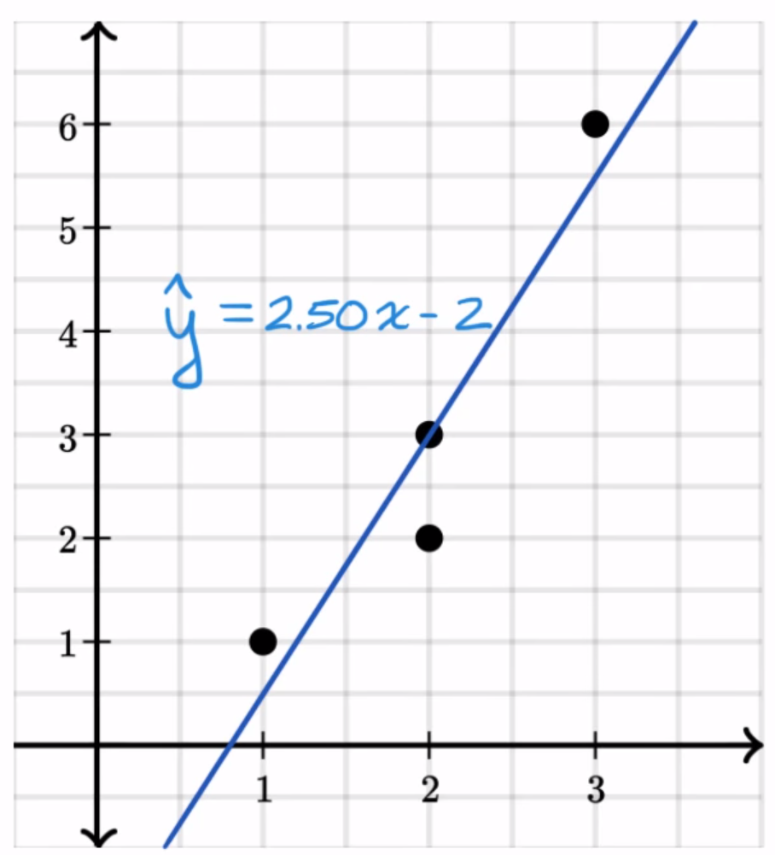
Matrices to check regression quality
How far our actual values are from predicted values. – Residual / deviation
www.anubhavtrainings.com

Slide 15
RMSE & MAPE
RMSD/RMSE – Root mean Square Residual (Error)
The value of RMSE can range between 0 to infinite which is difficult to be interpreted by the business, in order to make our business user understand the power of our model, we relies on a % based measure. This is called MAPE (Meal Absolute Percentage Error)
www.anubhavtrainings.com

Slide 16
End of Day 6

Slide 18

Questions

Slide 19

Anubhav Oberoy
anubhav.abap.@gmail.com

